Slide 1
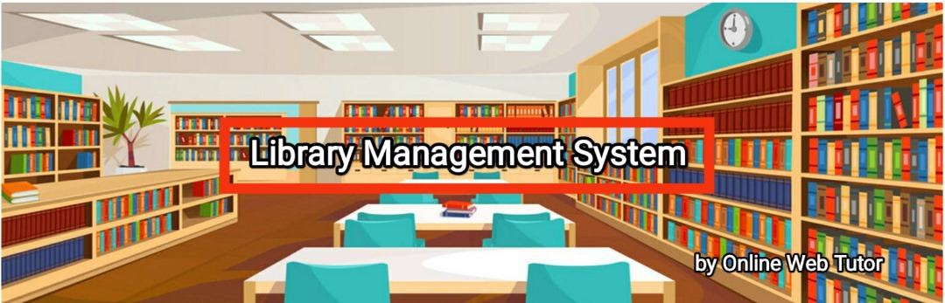
Library Management Database System

Slide 2
Project Overview
Project Design Description
In our Library Management Application, when we execute the application, it will show the main page which contains several options that users get registered and login within the application and every user will have some operations and communication between them including admin will add/update/delete book, those books will be viewed by both librarian and users. In the same manner Librarian will add new arrivals in market those details will be stored in the database and retrieved from the database [8].

Slide 3
Importance of Database
The database is central to our application. All user and book information is stored here. Operations like issuing or returning a book are performed through the database, ensuring data consistency, security, and ease of retrieval.

Slide 4
ER Diagram Overview
The Entity-Relationship (ER) Diagram includes entities such as Student, Faculty, Book, Registration, and Transactions. It shows how these entities relate to each other, using primary and foreign keys to establish connections.

Slide 5
Database Design:
Database is very important for our application because every user detail is stored and retrieved from the database, and we can also update or delete from database [9]. Each operation will have separate tables and they contain primary keys and foreign keys so that relation will be available between the tables. Authentication has been enhanced for user so that it would be helpful to improve more users to our application.

Slide 6
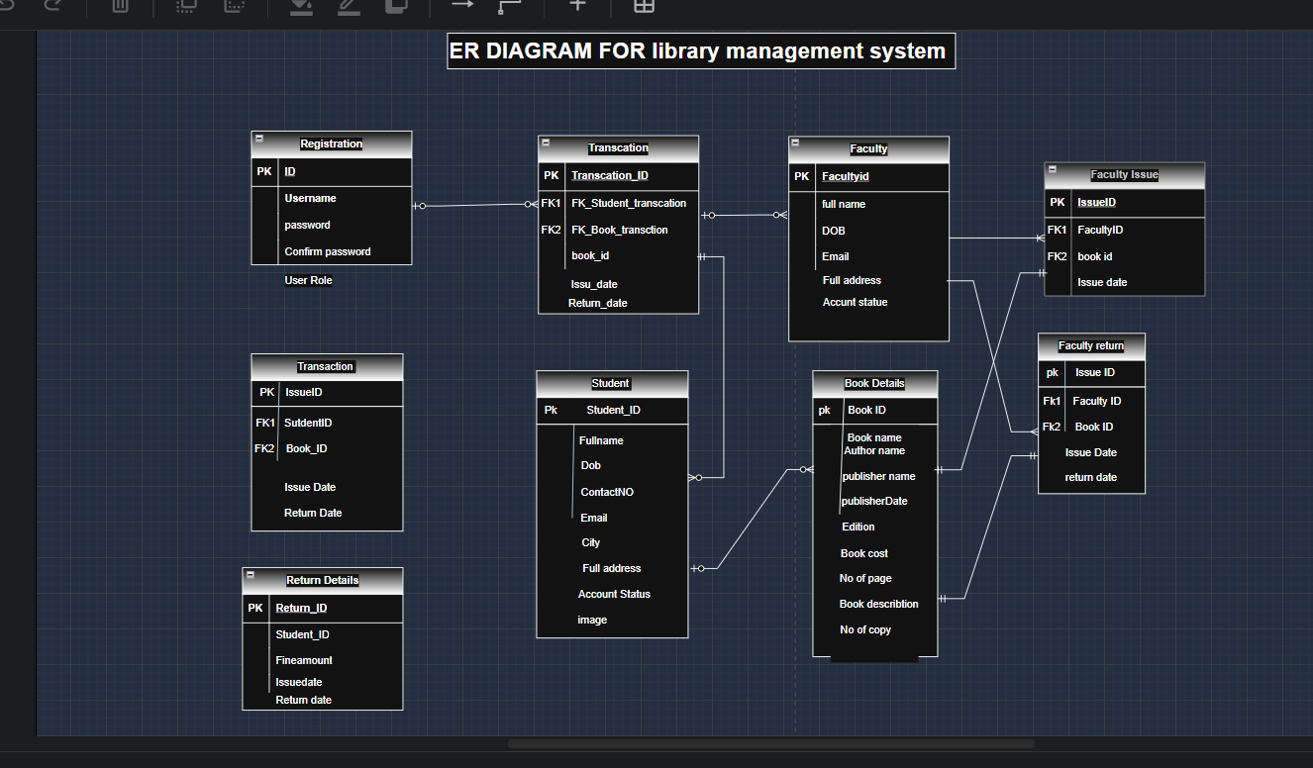
ER DIAGRAM FOR LIBRARY MANAGEMENT SYSTEM

Slide 7
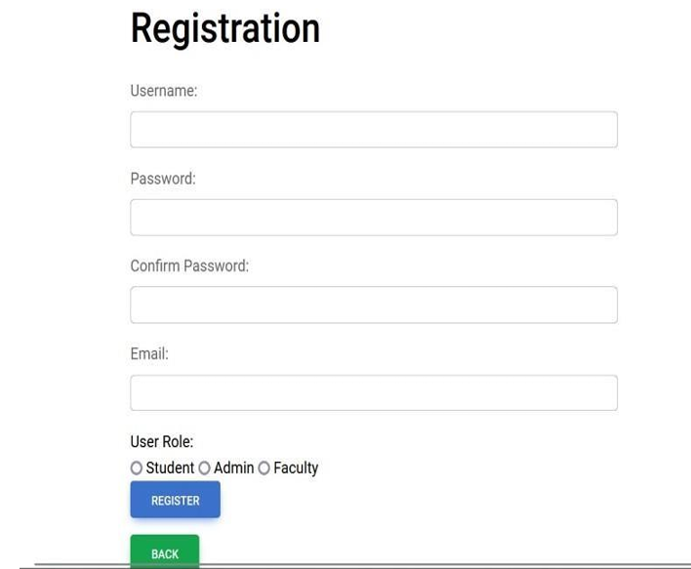
Registration Table
Stores login credentials for users.
Fields:
- ID (PK)
- Username
- Password
- Confirm Password
- User Role

Slide 8
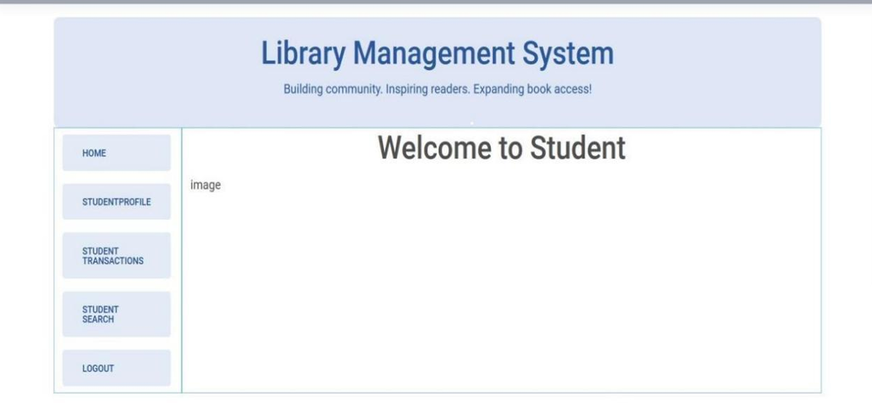
Student Table
Stores details of students who use the library.
Fields:
- StudentId (PK)
- Fullname
- ContactNo
- Email
- Address
- Account Status

Slide 9
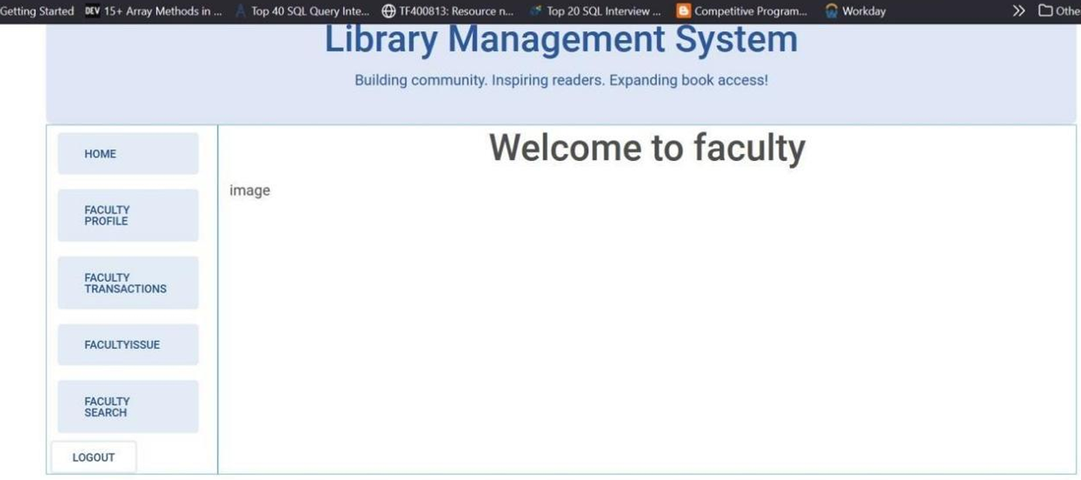
Faculty Table
Stores information about faculty members.
Fields:
- FacultyId (PK)
- Fullname
- ContactNo
- Email
- Address
- Account Status

Slide 10
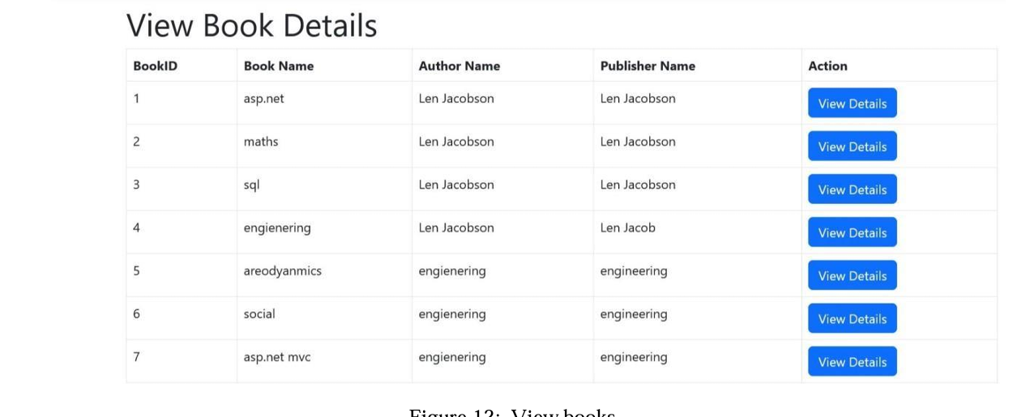
Book Details Table
Contains details of all books in the library.
Fields:
- BookId (PK)
- Bookname
- Authorname
- Publisher name
- Publish date
- Edition
- Book cost
- No. of pages
- Description
- No. of copies

Slide 11
Transaction Table
Records student transactions.
Fields:
- TransactionId (PK)
- StudentId (FK)
- BookId (FK)
- Issue Date
- Return Date

Slide 12
Issue Details Table
Logs each time a student borrows a book.
Fields:
- IssueId (PK)
- StudentId (FK)
- BookId (FK)
- Issue Date

Slide 13
Return Details Table
Logs return of books by students.
Fields:
- ReturnId (PK)
- BookId (FK)
- StudentId (FK)
- Return Date

Slide 14
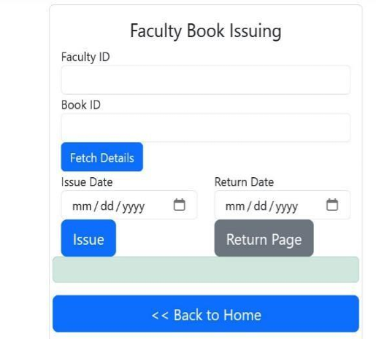
Faculty Issue Table
Logs books issued to faculty members.
Fields:
- IssueId (PK)
- FacultyId (FK)
- BookId (FK)
- Issue Date

Slide 15
Faculty Return Table
Tracks return of books by faculty.
Fields:
- IssueId (PK)
- FacultyId (FK)
- BookId (FK)
- Return Date

Slide 16
Relationships
Relationships are managed using foreign keys:
- Registration is linked to all users.
- Student and Faculty are linked to BookDetails through Transactions and Issue/Return tables.
- Transactions ensure tracking of book borrowing/returning.

Slide 17
Conclusion
This database efficiently handles user registrations, book inventories, and borrow/return activities. It uses well-defined relationships to ensure data integrity and is scalable for future additions like fines, notifications, or user analytics.

